Slide 1
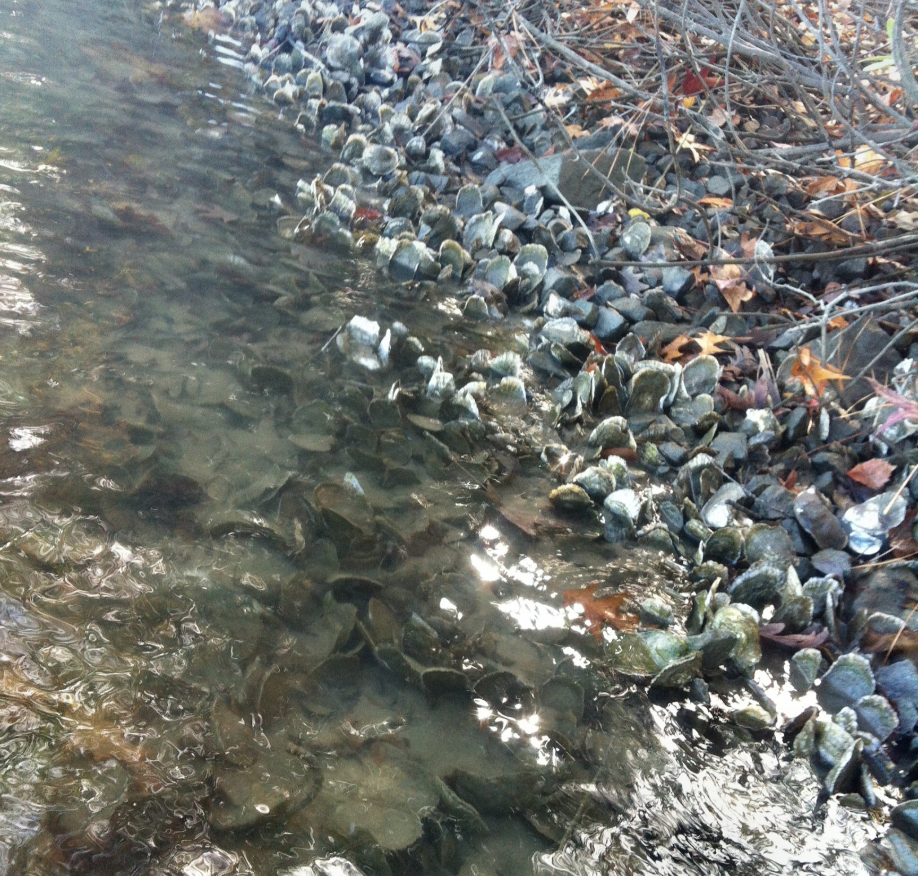
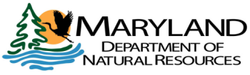
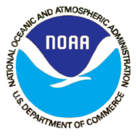
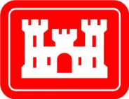

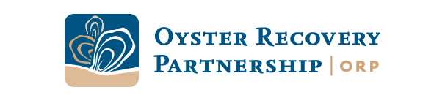
Oyster Restoration Overview
April 16, 2015
Status of resource and fishery
MD’s oyster restoration plan
Status of restoration projects

Slide 2
Maryland oyster harvest has declined from over 12 million bushels in the late 1800’s to less than 200,000 bushels in recent years. Harvest in the 2013 and 2014 seasons increased to over 400 thousand bushels but is still a fraction of historical harvests.
Despite a struggling population and low harvest, the oyster fishery remains one of Maryland’s most valuable.
$11.9 million average dockside value in the 2013 and 2014
$3.2 million average in the preceding 5 years (low harvest).

Slide 3
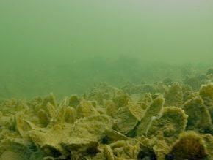
Science Based Oyster Restoration Plan
Programmatic Environmental Impact Statement (PEIS) for Oyster Restoration Alternatives in Chesapeake Bay
MD Oyster Advisory
Commission
MD Aquaculture Coordinating Council
Ten Point Plan
House Bill 312
Aquaculture Law
Expanded Sanctuary Network
Public Shellfish Fishery Areas
Aquaculture

Slide 4
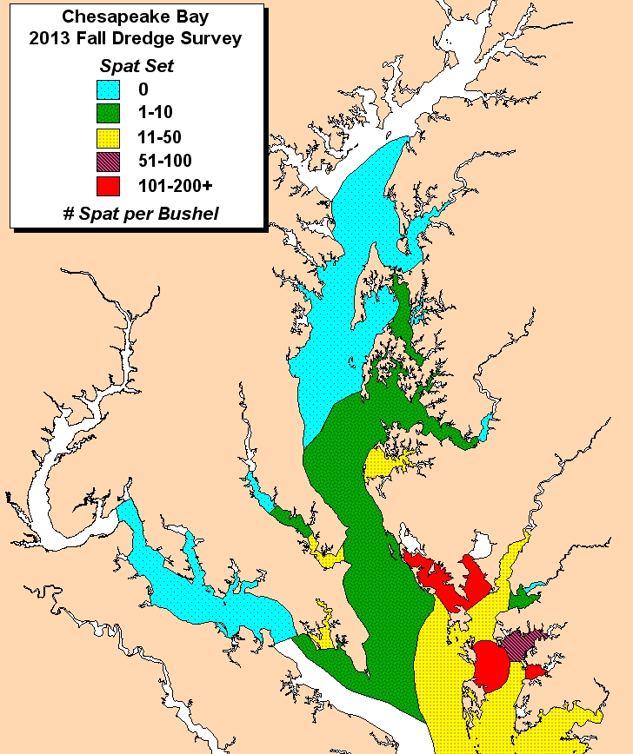
Planning around salinity which affects recruitment and survival

Slide 5
Maryland Oyster Sanctuaries Established in 2010
Protects 24% of oyster habitat.
Leave 76% for harvest.
A best bars analysis was conducted to determine most productive oyster bars.
50% of best bars were left for harvest and 50% protected.
Best bars are a small fraction of sanctuary areas – most are remnant bars that have restoration potential but have supported minimal harvest.

Slide 6
Creating the “Engines” that drive Bay-Wide Oyster Restoration
Within the expanded sanctuary network, and as recommended by the PEIS, Maryland and Virginia are focused on large-scale restoration of selected tributaries to drive bay-wide restoration of the oyster population.
As per the 2014 Bay Agreement, Maryland and Virginia are committed to restoring oyster populations in 10 tributaries – 5 in each state – by 2025.
Within Maryland:
  2 tributaries are well toward completion – Harris Creek (DNR and USACE co-leads) and Little Choptank (DNR lead).
  1 is about to begin – Tred Avon (USACE lead).
DNR and partners are committed to conducting a scientific evaluation of the success of these efforts and submitting a report by June, 2016.
Based on the findings of that evaluation, DNR is committed to working with the waterman community, scientists, and other stakeholders to designing and implementing an appropriate approach to the remaining two tributaries by 2025

Slide 7
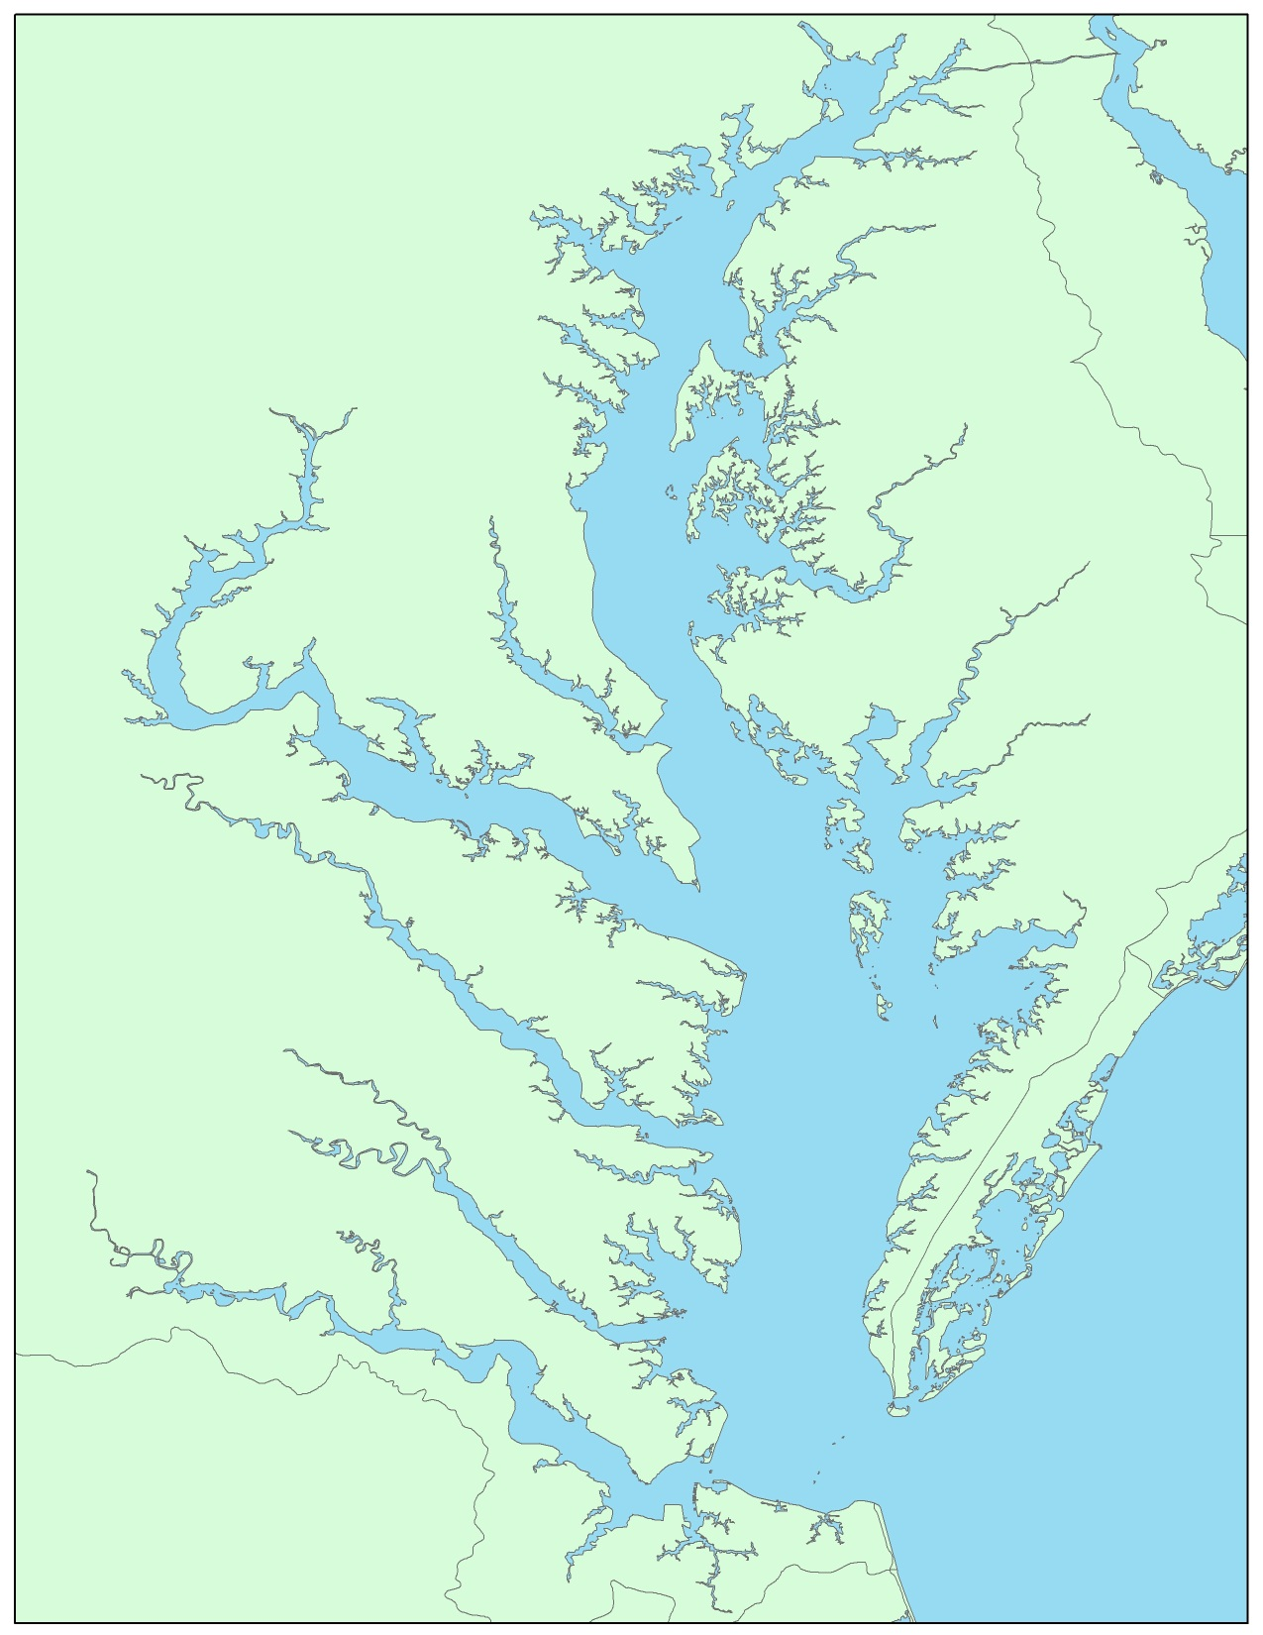
Harris Creek
Tred Avon
Why Sanctuaries?
Recommendation of PEIS
Create reproductive engines
Foster disease resistance
Build 3D reefs for ecological benefits
Little Choptank
Sanctuaries Selected for Active Restoration Work:
Harris Creek: DNR & Corps Lead
Little Choptank River: DNR Lead
Tred Avon: USACE Lead

Slide 8
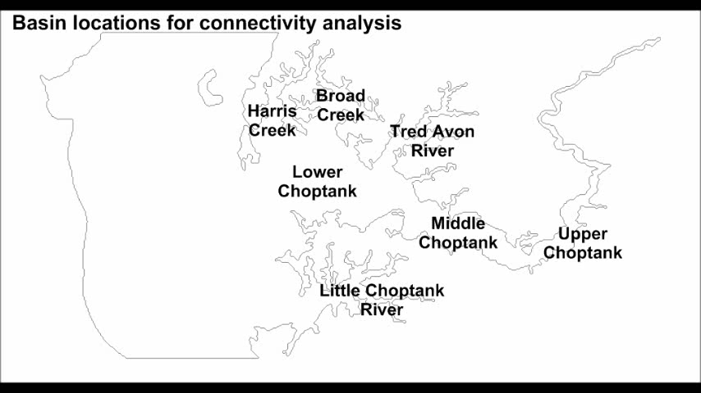
Sanctuaries Serve as Reproductive Engines

Slide 9
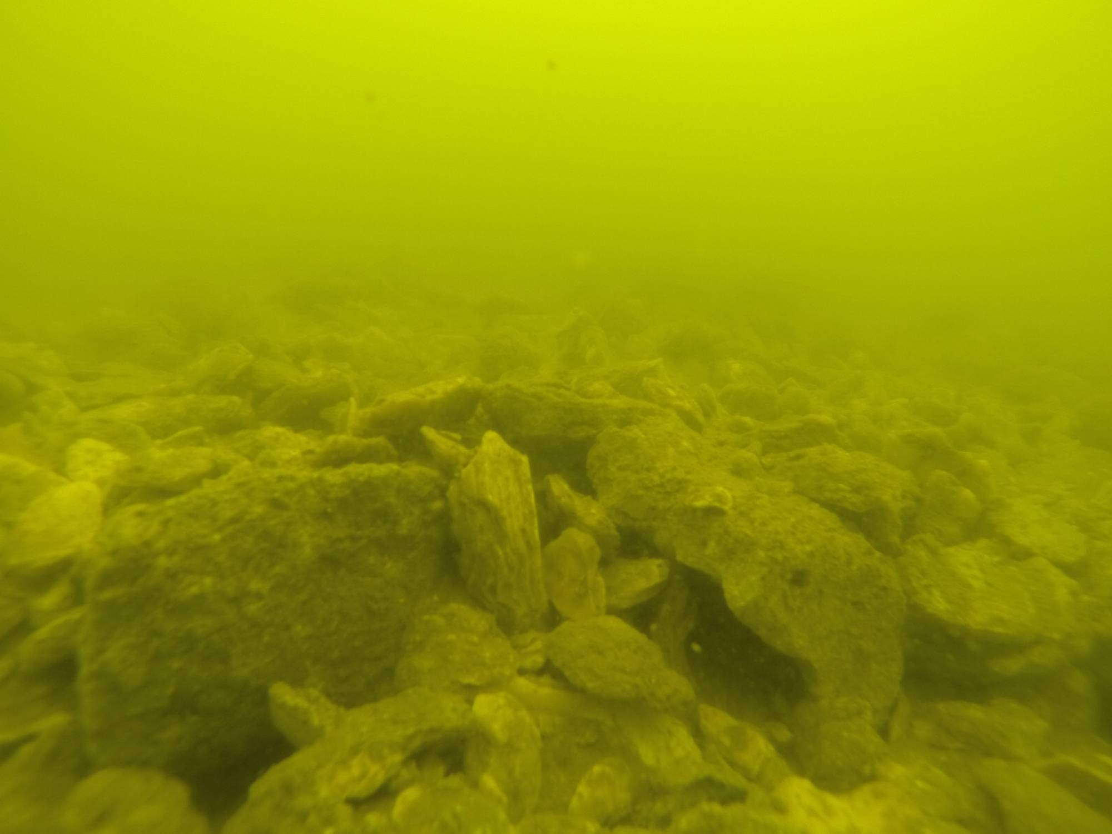
Status of Oyster Restoration Projects
(As of April 2015)
Project | Lead Agency | Partners | Acres for Restoration Target | Acres Restored (reefs constructed and seeded) | Acres Constructed (constructed and waiting seeding) | Oyster Seed Planted | Funds Spent
Harris Creek | DNR / USACE | NOAA, UMD, ORP, NFWF, TNC, CBF | 372 | 258 | 27 | 1.6 billion | $19 million 55% DNR, 27% USACE)
Little Choptank | DNR | NOAA, UMD, ORP, NFWF, TNC | 440 | 17 | 95 | 81 million | $15 million (85% DNR, 0% USACE)
Tred Avon | USACE | NOAA, DNR, UMD, ORP | 185 | 0 USACE | 0 | 0 DNR | (>90% USACE, <10% DNR,)

Slide 10
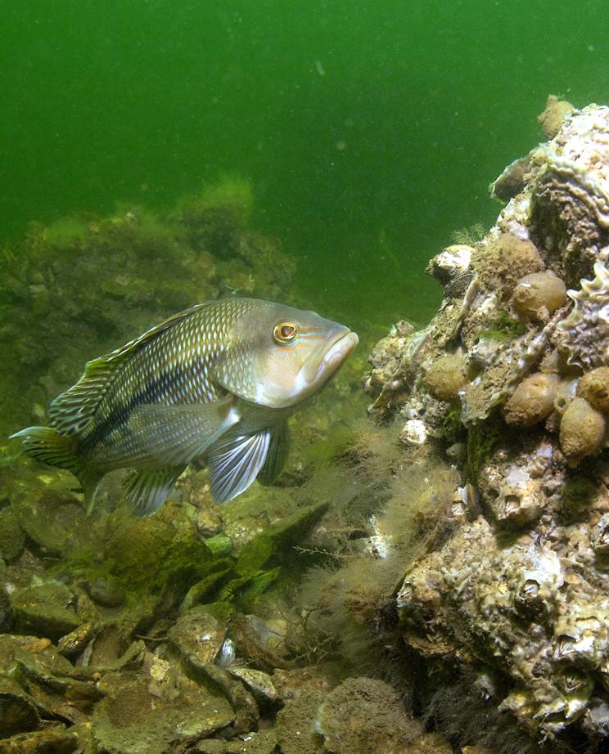
How are We Doing?

Slide 11
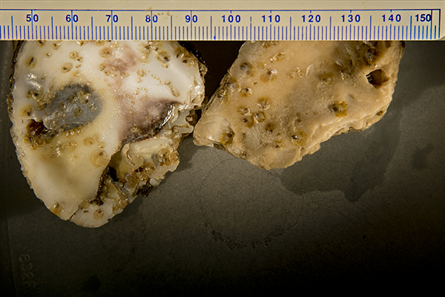
Harris Creek Results so far…
30% spat survival – twice anticipated rate
Excellent growth (2 year old oysters nearly 3 inches at one sentinel site).
Dermo is present, but at sub-lethal levels; could see outbreak in a dry year but this would foster natural disease resistance.
Continuous water quality monitoring shows no red flags.

Slide 12
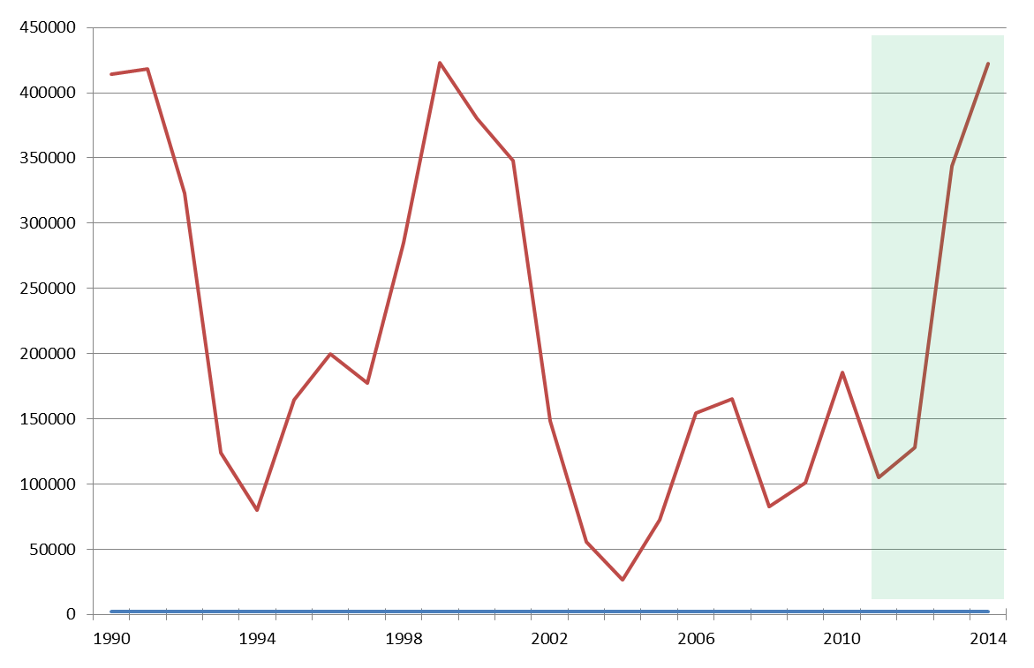
Maryland Oyster Harvest Before and After Sanctuaries
10% of 2009-2010 harvest within sanctuary network
32% harvest decline in first year
Harvest increased nearly four-fold since 2011 (124K bu vs. 422K bu)
Sanctuaries
Implemented
Harvest
(bushels)

Slide 13
Oyster Restoration Overview
April 16, 2015

